Slide 1

What’s in Your Food?
A Data-Driven Nutrient Analysis
By Alina Yildir
Please read more at https://medium.com/@yildir.a.mdsa/whats-in-your-food-a-data-driven-nutrient-analysis-e3a0f7a5c553.

Slide 2
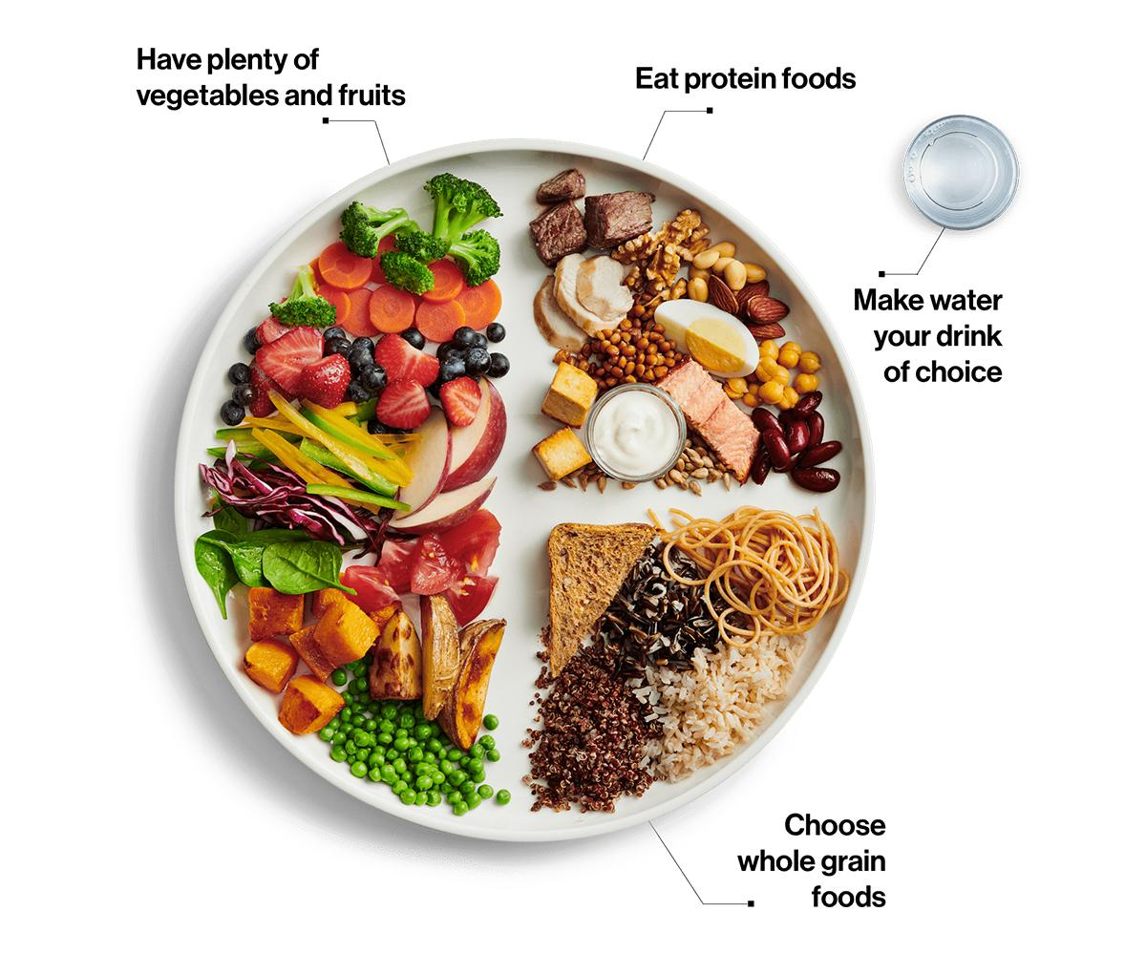
Introduction
According to Canada’s Food Guide, maintaining a balance of nutrients such as protein, fibre, carbohydrates, and potassium contributes to better overall health. At the same time, reducing the intake of saturated fat, trans fat, sugar, sodium, and cholesterol plays a key role in minimizing health risks.
Image source: Canada’s Food Guide, Government of Canada. Retrieved from https://food-guide.canada.ca/en/.

Slide 3
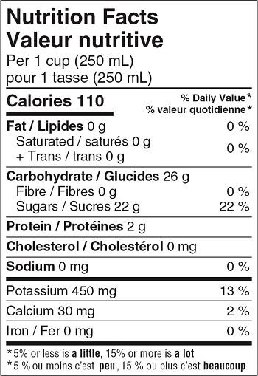
Objectives
The objective is to analyze food categories, subcategories, and individual foods to identify the highest and lowest levels of the 12 key nutrients from the Nutrition Facts Table, compare protein-to-fat ratios across subcategories, and evaluate nutrient density per calorie for macronutrients (carbohydrates, protein, and fat).
Image source: Nutrition Facts Tables, Government of Canada. Retrieved from https://www.canada.ca/en/health-canada/services/food-nutrition/nutrition-labelling/nutrition-facts-tables.html.

Slide 4

Data Preprocessing
Dataset: The Canadian Nutrient File (Health Canada) – provides nutrient data for 1,000+ commonly consumed foods, covering 19 key nutrients.
Original Format: 17 separate CSV files (one per food category).
Preprocessing Steps (applied to each file individually):
Removed unnamed rows/columns containing only missing values.
Flattened multi-level headers while preserving relevant subheadings.
Selected 12 key nutrients based on Nutrition Facts Table guidelines.
Standardized column names to align with Health Canada’s format.
Replaced "tr" (trace amounts) and "N/A" (no suitable value available) with 0.
Added the missing + Trans (g) column where necessary.
Retained only relevant columns and reordered them for consistency.
Normalized nutrient values to be per 100g instead of per serving size for standardization.
Final Merged Dataset: 1,098 foods, 16 columns (Food Name, Calories, Fat, Carbohydrates, Protein, Sodium, Iron, etc.).
Please read more at https://github.com/yildiramdsa/nutrient_composition_of_common_foods_in_canada_analyzing_the_canadian_nutrient_file/blob/main/notebooks/data_preprocessing.ipynb.

Slide 5
Question 1. Which food categories contain the highest and lowest levels of the 12 key nutrients listed in the Nutrition Facts Table?
Question 2. Within a selected food category, which subcategories have the highest and lowest levels of these nutrients?
Question 3. Within a selected subcategory, which individual foods have the highest and lowest levels of these nutrients?
https://public.tableau.com/app/profile/alina.yildir/viz/AData-DrivenNutrientAnalysis/AData-DrivenNutrientAnalysis2
https://public.tableau.com/app/profile/alina.yildir/viz/AData-DrivenNutrientAnalysisPerServing/AData-DrivenNutrientAnalysis

Slide 6

Question 4. Which food subcategories have the highest and lowest protein-to-fat ratios?
https://public.tableau.com/app/profile/alina.yildir/viz/AData-DrivenNutrientAnalysis/AData-DrivenNutrientAnalysis2

Slide 7
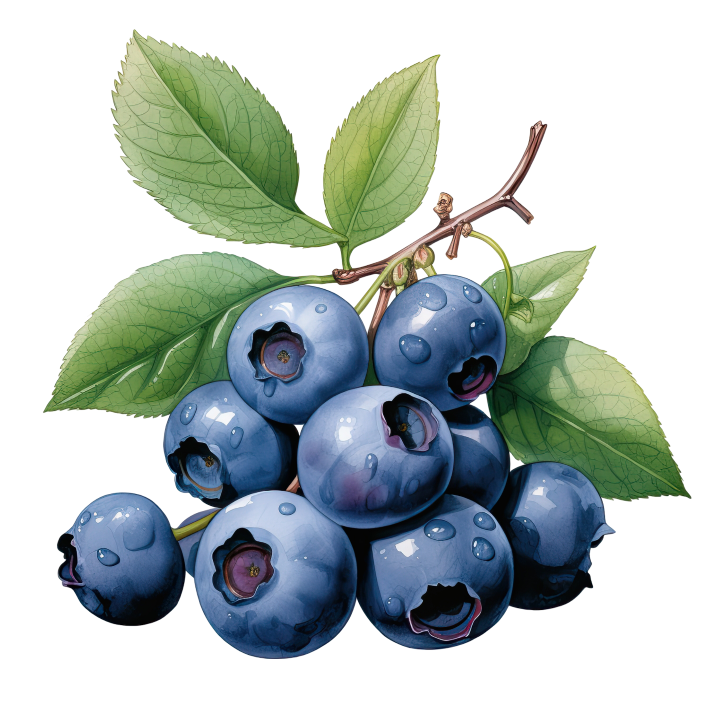
Question 5. Which food subcategories have the highest nutrient density per calorie, particularly for macronutrients (carbohydrates, protein, and fat)?
https://public.tableau.com/app/profile/alina.yildir/viz/AData-DrivenNutrientAnalysis/AData-DrivenNutrientAnalysis2
https://yildiramdsa-nutrient-composition--csv-chatbotcsv-chatbot-kdmzcd.streamlit.app

Slide 8

Database Chatbots: Interacting with CSV Data
1
2
…
df['Protein per Calorie'] = df['Protein (g)'] / df['Calories']
df['Fat per Calorie'] = df['Fat (g)'] / df['Calories']
df['Non-Sugar Carbs per Calorie'] = df['Non-Sugar Carbohydrates (g)'] / df['Calories']
df[['Food Category', 'Protein per Calorie', 'Fat per Calorie', 'Non-Sugar Carbs per Calorie']].groupby('Food Category').mean()
…
Which food categories have the highest nutrient density per calorie, particularly for protein, fat, and non-sugar carbohydrates?
4
3
…
Food Category Protein per Calorie
Baked Goods 0.015058
Beverages 0.003933
…
Food Category Fat per Calorie
Baked Goods 0.015058
Beverages 0.003933
…
Food Category Non-Sugar Carbs per Calorie
Baked Goods 0.095682
Beverages 0.078777
…
Protein Density: The 'Fish and Shellfish' category has the highest protein density per calorie, making it an excellent choice for high-protein diets. This is followed by 'Meat and Poultry', and 'Eggs and Egg Dishes'.
Fat Density: The 'Fats and Oils' category leads with the highest fat density per calorie, followed by 'Eggs and Egg Dishes' and 'Legumes, Nuts and Seeds'.
Non-Sugar Carbohydrate Density: 'Breads, Cereals and Other Grain Products' rank highest, making them ideal for diets that focus on high fiber and complex carbohydrates. This is followed by 'Vegetables and Vegetable Products' and 'Snacks'.

Slide 9

Summary
Identified food categories with the highest and lowest levels of 12 key nutrients.
Analyzed subcategories within each food category to determine nutrient variation.
Examined individual foods within subcategories to highlight the most and least nutrient-dense options.
Compared food subcategories based on protein-to-fat ratios.
Evaluated nutrient density per calorie for macronutrients (carbohydrates, protein, and fat).

Slide 10

References
Government of Canada. (n.d.). Canada’s food guide. Retrieved from https://food-guide.canada.ca/en/.
Government of Canada. (n.d.). Nutrition facts tables. Retrieved from https://www.canada.ca/en/health-canada/services/food-nutrition/nutrition-labelling/nutrition-facts-tables.html.
Government of Canada. (n.d.). Canadian nutrient file. Retrieved from https://open.canada.ca/data/en/dataset/a289fd54-060c-4a96-9fcf-b1c6e706426f.

Slide 11

Thank You for Your Attention!
Please read more at https://medium.com/@yildir.a.mdsa/whats-in-your-food-a-data-driven-nutrient-analysis-e3a0f7a5c553.

